Slide 1
Desoutter Industrial Tools
Nantes & 11/2015

Slide 2
Revision
Revision n° | Date | Modification | Author
1.0 | 09/11/2015 | Creation | XRI / APA
1.1 | 25/01/2016 | Update document to be accurate with v6.0.44.528 | APA
2.0 | 05/05/2016 | Update document to be accurate with v6.3.13.1371 | APA
2.0 | 11/05/2016 | Update document to be accurate with v6.4.x.x | APA

Slide 3
Table of contents
Overview
Presentation
In-Application Features
Asset
User
Variant
Station
Process
Reporting
Station update
3

Slide 4
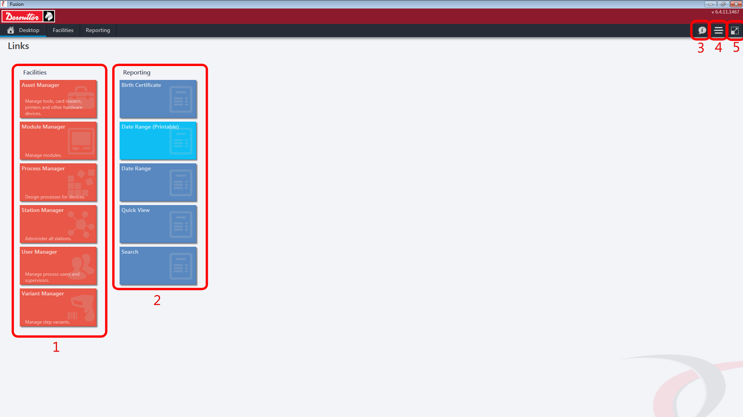
Overview
Generalities Presentation Settings Station update
CVI Fusion is an all-encompassing desktop management application allowing a user true ownership of their manufacturing environment from one single platform.
From Fusion a user can manager all processes, stations, assets, modules, users and zones inside of a production work space.
Facilities – All main application menu allowing user to configure set-up of process control environment
Reporting – Views available to the user for viewing traceability inside of CVI Fusion
Information – Opens a dialog box showing support information and Fusion version
Fusion Connection Mode – Allows user to change connectivity mode of Fusion between Offline, Database Server (SQL) and Web Service.
Shows/hides top banner of application
4

Slide 5
Overview
Generalities Presentation Settings Station update
Process Control Architecture
CVI Fusion is installed on to the same the same machine as the FusionCORE SQL database or on a separate machine with network connectivity to the database.
Once installed it has access to the same network as the Infinity station and can deploy settings/configurations to them.
Inside of Fusion reporting can be used to view traceability captured in the FusionCORE database by Desoutter CORE Services.
5

Slide 6
Presentation
Overview Presentation Settings Station update
CVI Fusion software is a Windows based software supported by both 64-bit and 32-bit operating systems.
Supported Operating Systems
Windows 7 (64-bit and 32-bit) with at least SP1
Windows 8 (64-bit and 32-bit)
Windows 10 (64-bit and 32-bit)
6

Slide 7
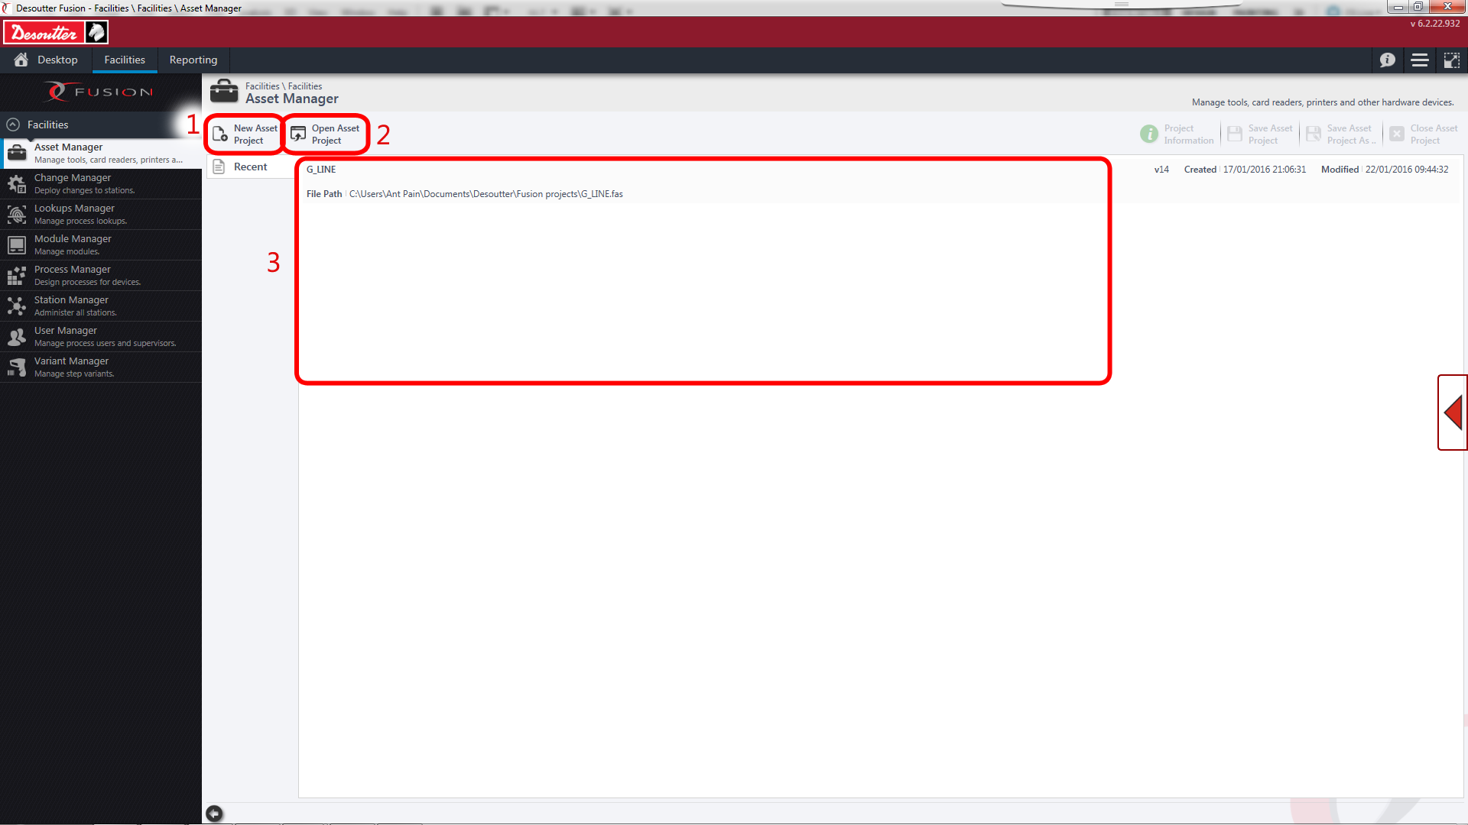
Fusion Layout (Pre-Opening a Project)
Features
Overview Presentation Settings Station update
All panes within CVI Fusion follow the same format/layout making it easy for the user to navigate and become familiar with the software. See below for generic format before opening a project on each pane.
New Project – Allows the user to create a new project
Open Project – Allows the user to open an existing project
Recents – Lists recent projects that have been opened
7

Slide 8
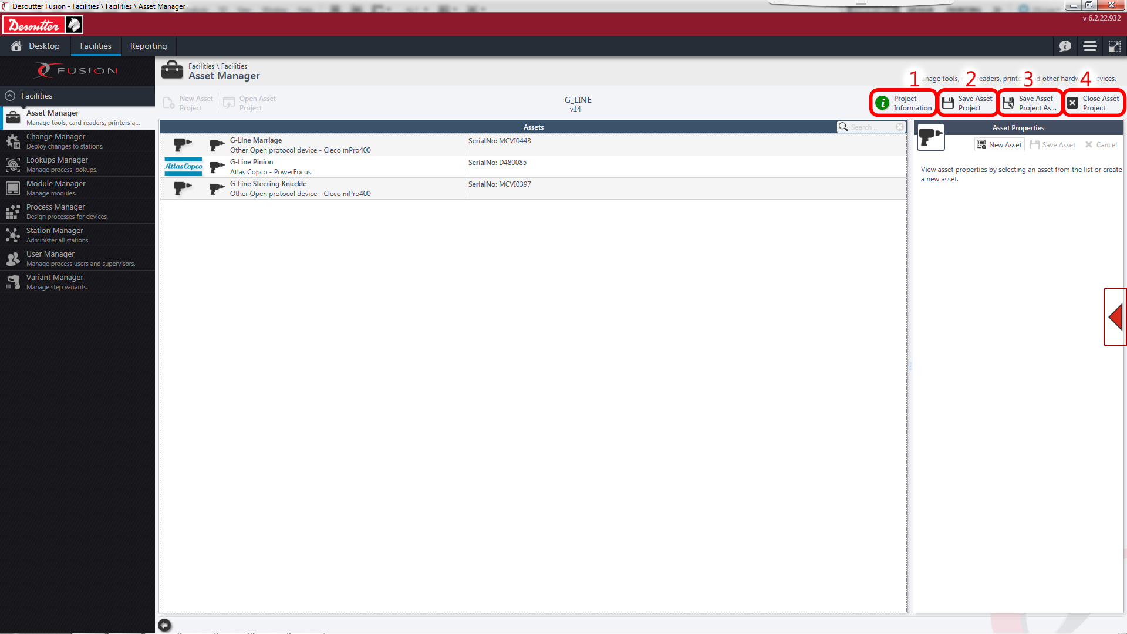
Fusion Layout (Post-Opening a Project)
Features
Overview Presentation Settings Station update
All panes within CVI Fusion follow the same format/layout making it easy for the user to navigate and become familiar with the software. See below for generic format after opening a project on each pane.
Project Information – Allows the user to open information regarding project such as name, description, creation date, modification date and any errors in loading.
Save Project – Allows the user to save the currently open project to the source file
Save Project As… - Allows the user to save the currently open project as a new file
Close Project – Allows the user to close the currently open project (prompts to save any unsaved changes)
8

Slide 9
In-Application Features
Features
Overview Presentation Settings Station update
Facilities
Asset Manager – Allows the user to manage hardware within processes and assign them to stations
User Manager – Allows the user to manage users/supervisors of stations
Variant Manager - Allows the user to manage variants used in conjunction with processes
Module Manage – Allows the user to administer the configuration of Infinity module devices
Station Manager - Allows the user to administer the configuration for stations
Process Manager – Allows the user to design and deploy processes to stations
9

Slide 10
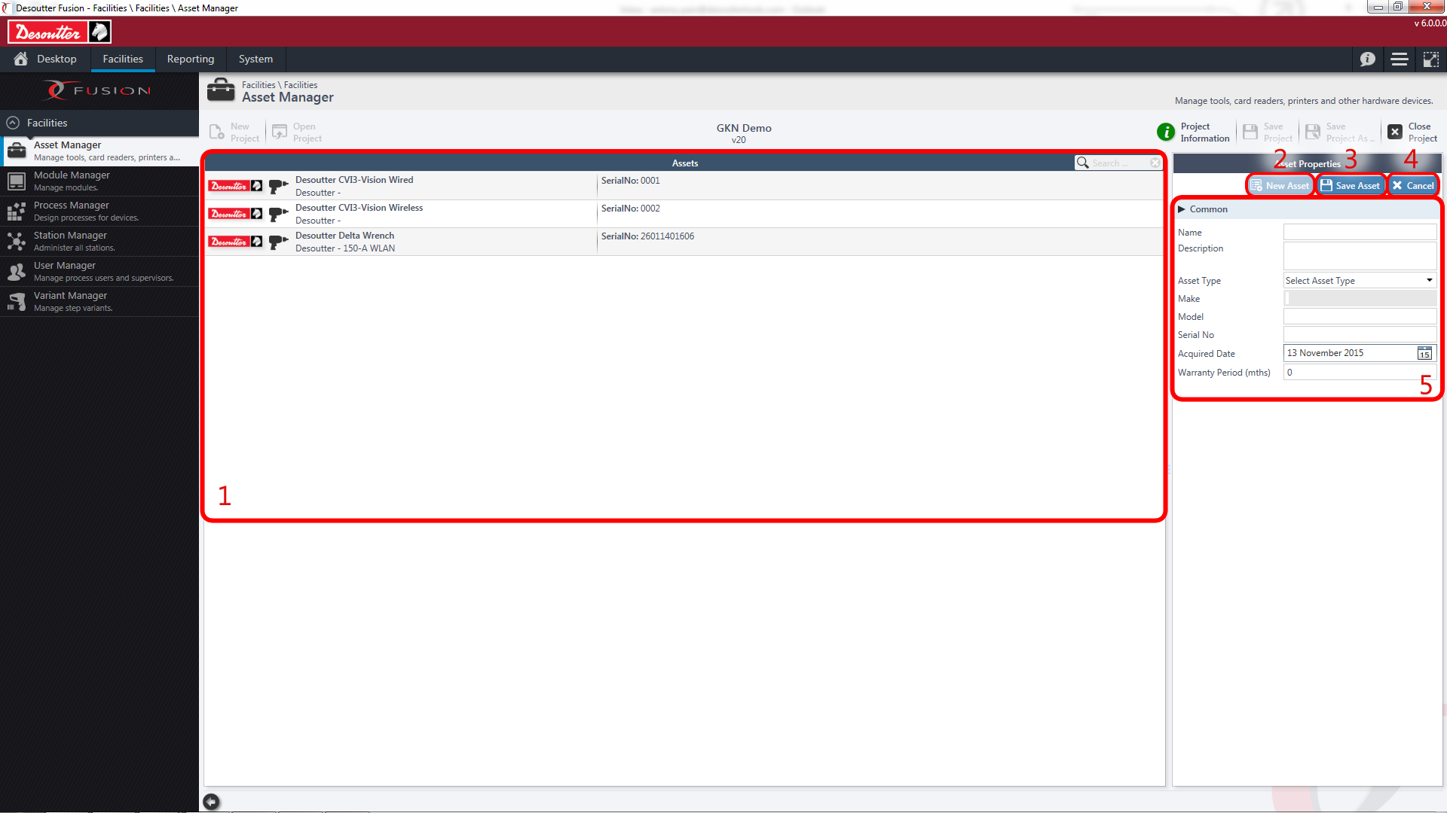
Features
Overview Presentation Settings Station update
Asset Manager Overview
Asset Manager is the main facility that allows the user to manage hardware within processes and assign them to stations; users are able to add tooling, card readers, printers and scanners to their assets and define their properties in the right-hand pane.
Assets – List of assets in the open project
New Asset – Allows user to add a new asset to the project
Save Asset – Allows user to save changes to an existing asset
Cancel – Allow user to cancel any unsaved changes/close asset properties
Common Properties – Common properties for each type of asset which alter properties per asset type
10

Slide 11
Features
Overview Presentation Settings Station update
Asset Manager : Different Asset Types
Supported Assets in CVI Fusion:
Card Readers:
- ACS ACR122S
Printers:
- Serial Zebra Printers
Scanners:
- Motorola
- Datalogic
- Other
Tools:
- Desoutter
- CVI3 - CVIxII
- Desoutter WLAN Tool
- DC Open Protocol
- Atlas Copco
- DC Open Protocol
- Crane
- Crane Ethernet
- Makita
- Stanley
- Other Protocol Tool
11

Slide 12
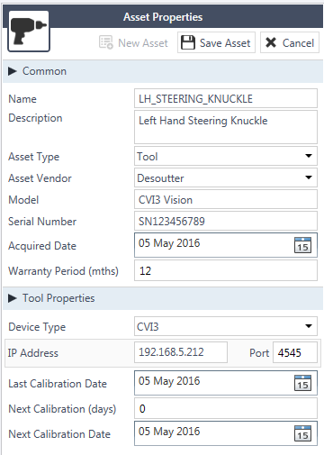
Features
Overview Presentation Settings Station update
Asset Properties
Once an asset has been selected in the common properties (See Asset Manager Overview) then properties for that specific type of hardware will populate underneath. See below for an example with a Desoutter CVI3.
As seen here, properties for the tool’s IP address are now available as well as calibration details if required.
If this tool is used in any processes inside of the site then settings can be changed here to alter the properties for every associated tightening rather than having to alter the properties on each instance of the tool
12

Slide 13
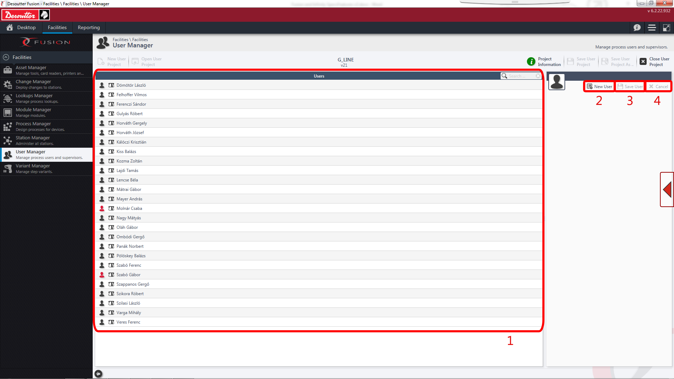
Features
Overview Presentation Settings Station update
User Manager Overview
User Manager allows the user to manage login details for operators/supervisors of stations; by defining someone as a supervisor it allows the system to grant different access levels to someone defined as a standard user.
Users - List of users in the open project
New user – Allows the user to add a new user to the current project
Save User – Allows the user to save any changes made to the open user
Cancel – Allows the user to close the open user profile
13

Slide 14
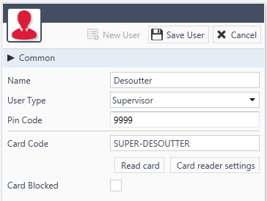
Features
Overview Presentation Settings Station update
User Properties
Once a user has been created or selected a user in Fusion then some common properties will open on the right-hand pane. These properties allow the user to set log in details and permissions for that user. See below for an example.
As seen here, properties for the user can now be set to determine whether they have supervior or operator powers on an Infinity Station.
The users log-in pin code can be set here as well as the card expected on their log-in card if used.
14

Slide 15
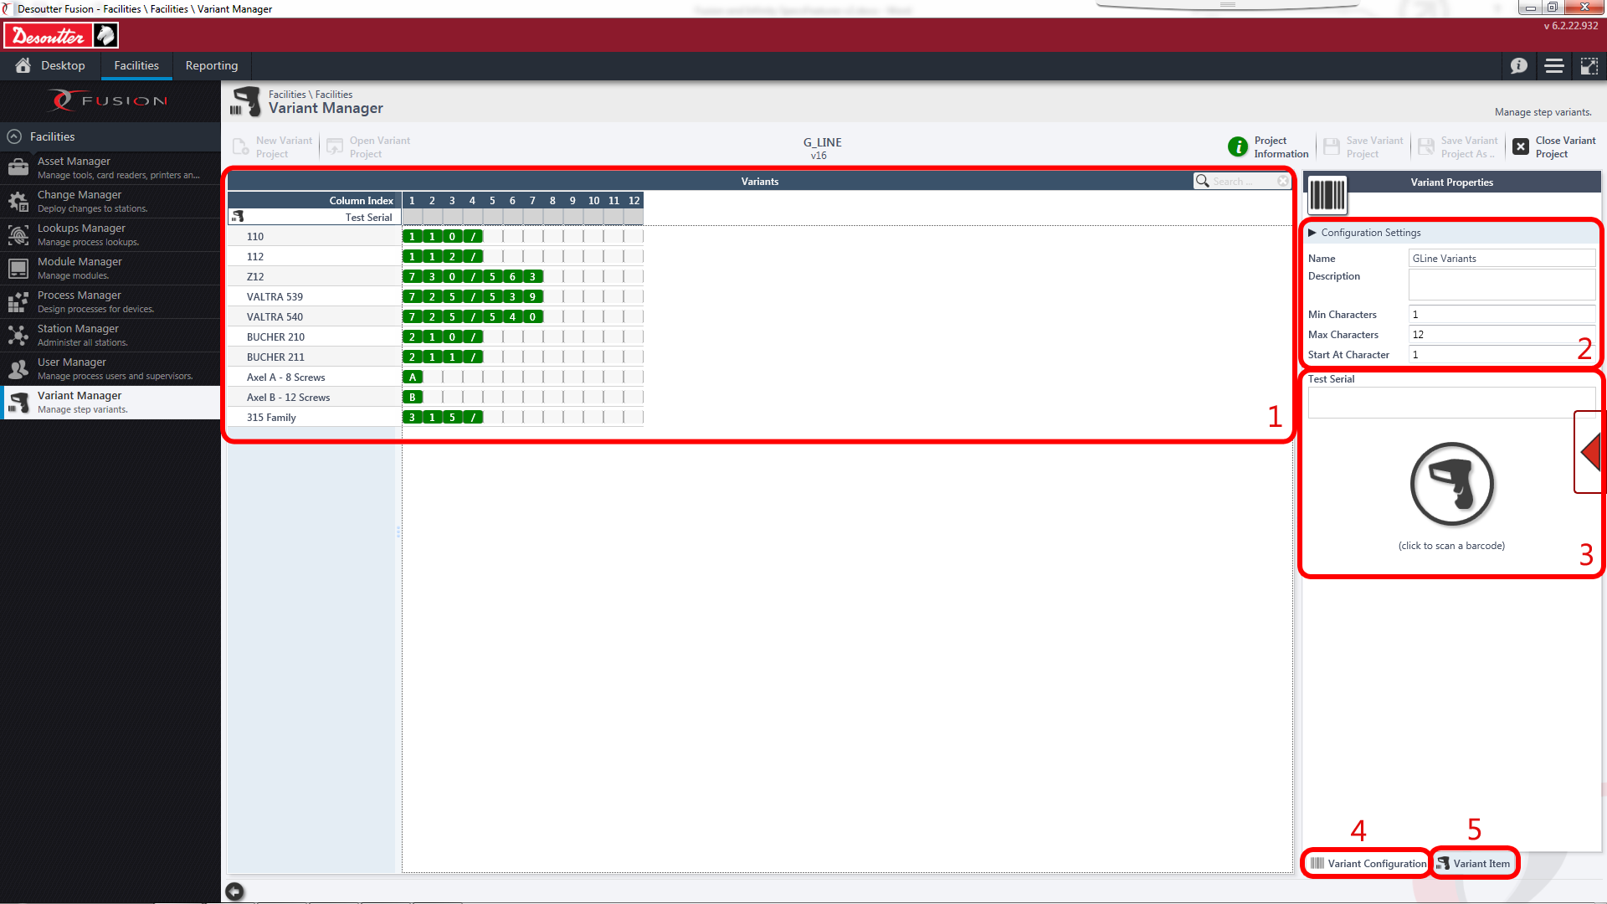
Features
Overview Presentation Settings Station update
Variant Manager Overview
Variant Manager is the main facility that allows the user to manage variants used in conjunction with steps in a process. Users are able to define variants based on build data and then later assign these variants to specific steps in process manager
Variants – List of variants in the open project
Configuration Settings – Pane that allows user to set rules for identifiers and general properties for variant project
Test Serial/Scan-mode – Allows user to scan a barcode into Fusion as test data, graphics show which variant apply to scanned/entered barcode
Variant Configuration – Opens Variant Configuration Pane
Variant Item – Opens Variant Item Pane
15

Slide 16
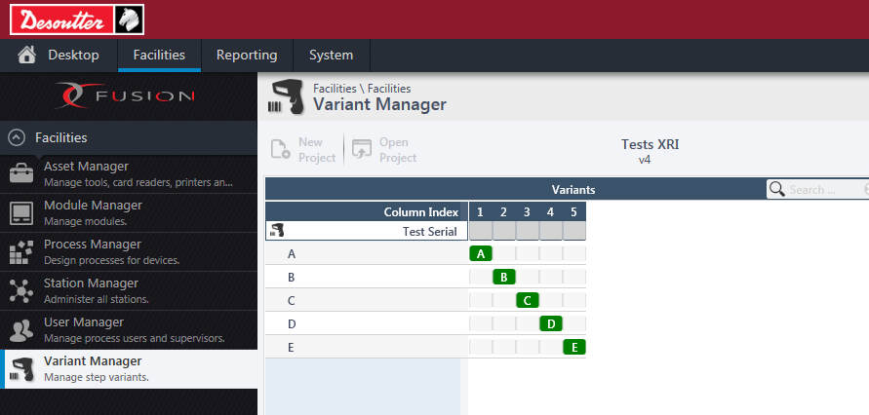
Features
Overview Presentation Settings Station update
What is a variant?
In a process we are supplied build data from a higher level system or user input. This is checked against the list of variants and their criteria. If a step in a process is associated to this variant then it is used in the cycle, otherwise it is filtered out and ignored.
Example:
If the build data had an ‘A’ in character position one that it is identified as Variant ‘A’ and would use any steps that this variant has been selected on.
16

Slide 17
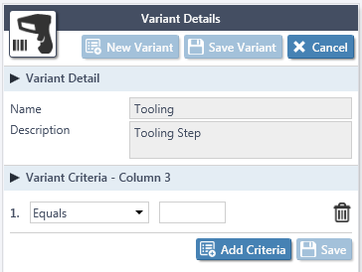
Features
Overview Presentation Settings Station update
Variant Item Properties
In Variant Manager, a user can create a variant and then defines rules for each character. A variant is seen as applicable if all conditions of the variant have been met. Once a variant has been created, the user can click each character to bring up the below menu to set rules.
As seen here, the variant is “Tooling” and Character 3 must = x for the variant to be used in a process.
17

Slide 18
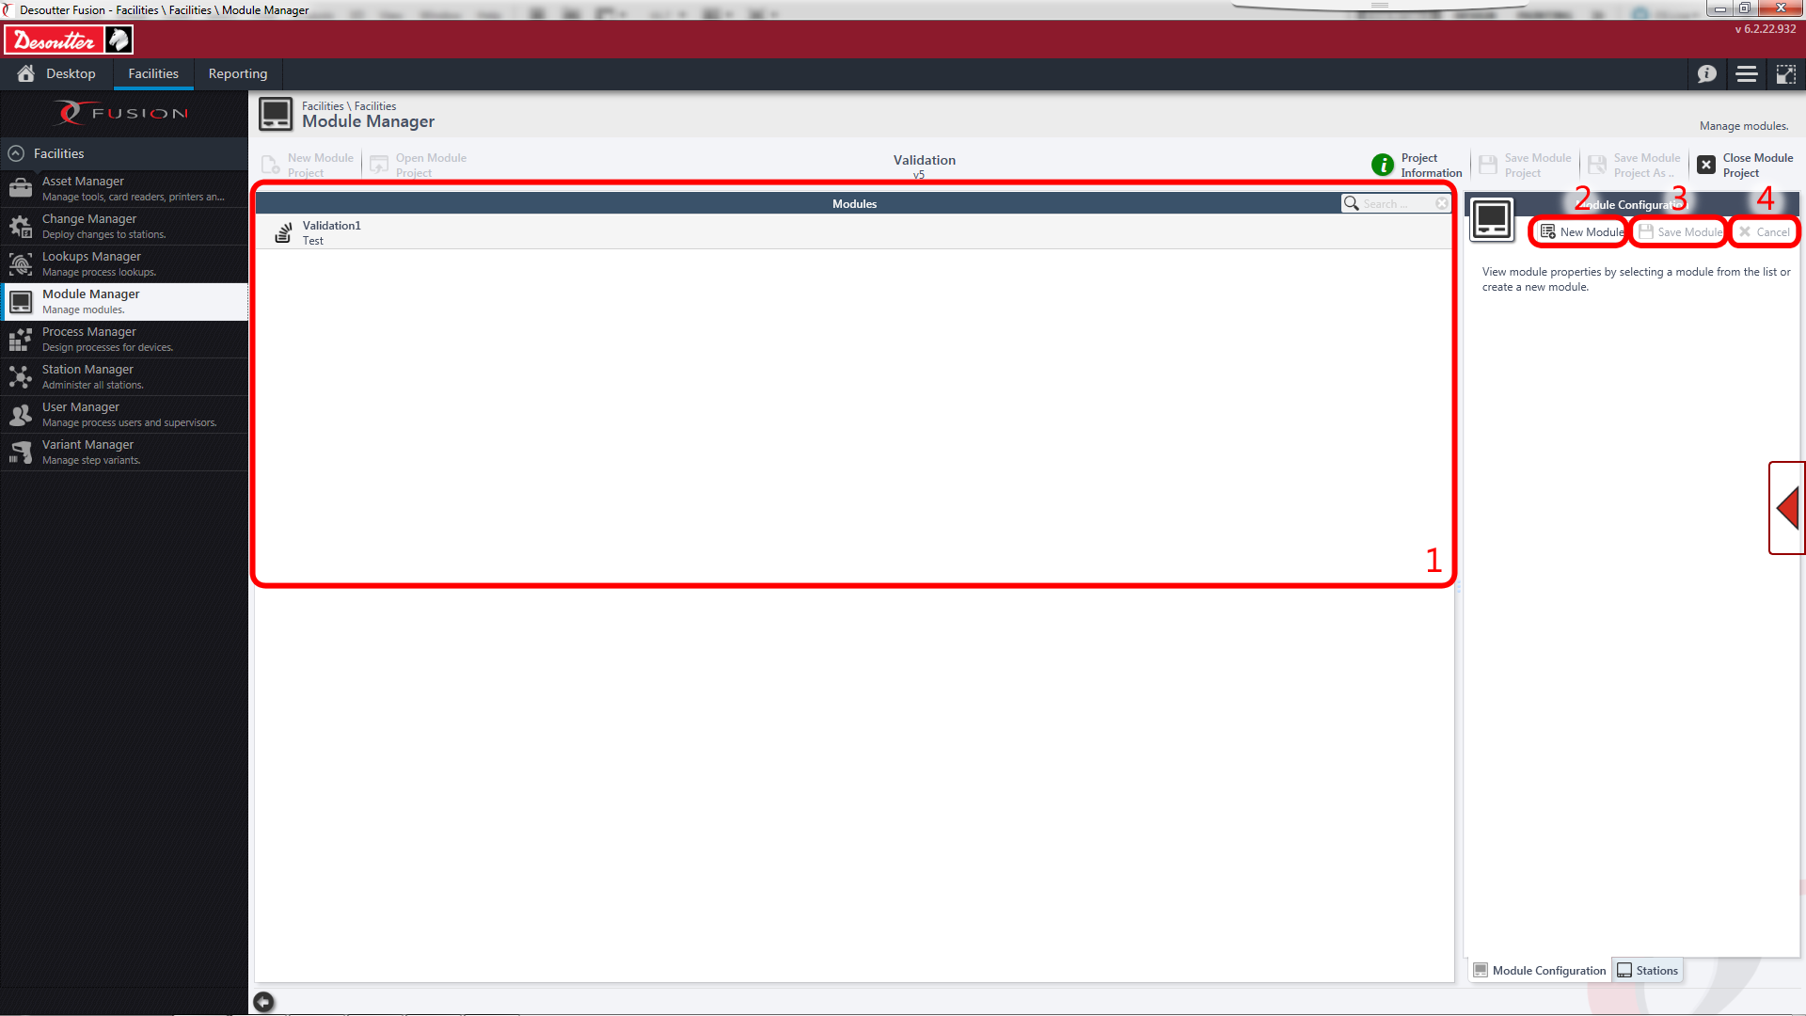
Features
Overview Presentation Settings Station update
Module Manager Overview
Module Manager allows the user to manage settings and configurations used on module devices such as Builder and Tracker. It allows the user to define the configuration used in these devices and deploy them remotely to the stations.
Modules - List of modules in the open project
New Module – Allows the user to add a new module to the current project
Save Module – Allows the user to save any changes made to the open module
Cancel – Allows the user to close the open module’s properties
18

Slide 19
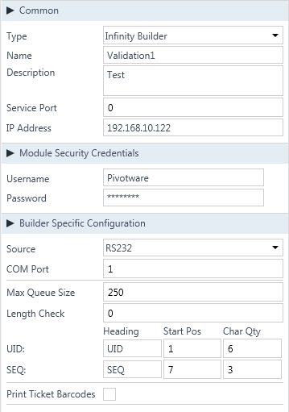
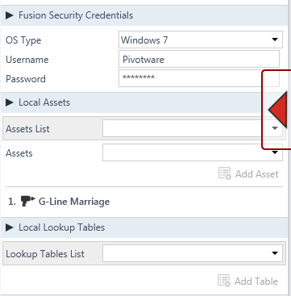
Features
Overview Presentation Settings Station update
Station Properties
Once a module has been created/opened the user has the options to change the configuration of the module device.
Infinity Builder
Builder takes data from a high level system or through manual input to create a list of build data. This data is then automatically sent to all connected Infinity devices so that they do not have a need for scanning build data manually.
Available Configuration Settings define:
Where the devices build source comes from
The number of builds in the queue at any one time
The UID and SEQ in the data
Whether a user of Builder has the ability to print individual tickets
19

Slide 20
Features
Overview Presentation Settings Station update
Station Properties
Once a module has been created/opened the user has the options to change the configuration of the module device.
Infinity Builder
Builder takes data from a high level system or through manual input to create a list of build data. This data is then automatically sent to all connected Infinity devices so that they do not have a need for scanning build data manually.
Available Configuration Settings define:
Where the devices build source comes from
The number of builds in the queue at any one time
The UID and SEQ in the data
Whether a user of Builder has the ability to print individual tickets
20

Slide 21
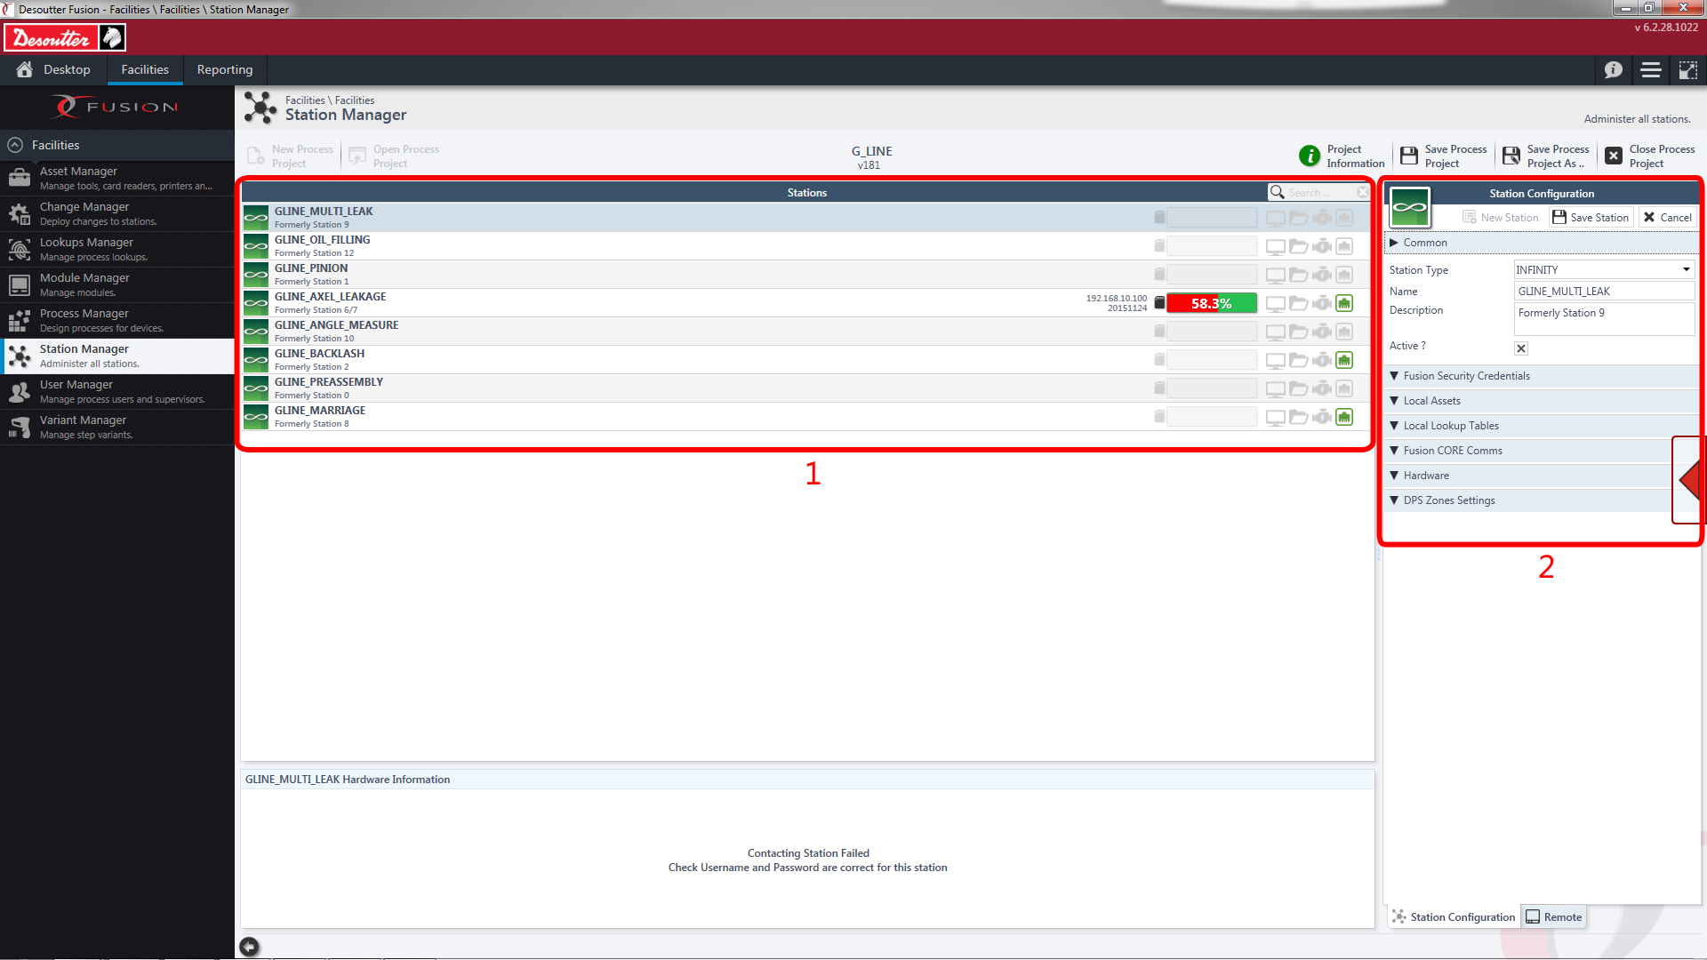
Features
Overview Presentation Settings Station update
Station Manager Overview
Station Manager allows the user of CVI Fusion to create and organise stations within a project. The facility also gives the user options to change critical settings to do with stations within the open project.
Stations – List of stations within open project including station status
Station Properties – Lists all configurable properties within a station
21

Slide 22
Features
Overview Presentation Settings Station update
Station Properties
Once a user has been created or selected a station then some common properties will open on the right-hand pane. These properties allow the user to set configuration for the station such as name, description, associated assets, hardware settings and DPS Zone settings.
Available Properties
- OS Type - Defines the operating system used for the station
- Username – The FTP Username for the station
- Password – The FTP Password for the station
- Assets List – Lists all available linked assets
- Assets – Shows user the assets that has been assigned to the open station
- Lookup Tables List – Lists all available linked lookup tables
- Lookups – Shows user the lookup tables that has been assigned to the open station
22

Slide 23
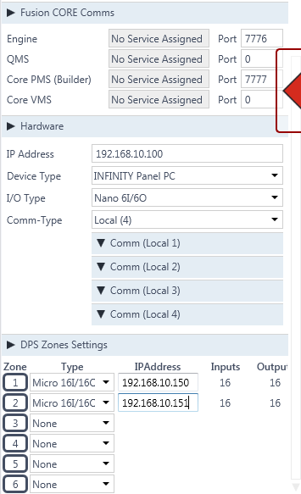
Features
Overview Presentation Settings Station update
Station Properties (Extended)
- Engine – Defines the Port used for the Engine traceability service
- QMS – Defines the Port used for the QMS service
- PMS – Defines the Port used for the PMS service
- VMS – Defines the Port used for the VMS service
- IP Address – Defines the IP Address of the station- Device type – Defines the type of device being used for the station
- I/O Type – Defines the type of local I/O being used
- Comm-Type – Defines the number of COM Ports being used in the station.
DPS Zone Settings
- Allows the user to define the remote I/O being used by the station for digital picking systems. Infinity currently supported by 6 zones of I/O; management is controlled by process and hardware settings set here.
23

Slide 24
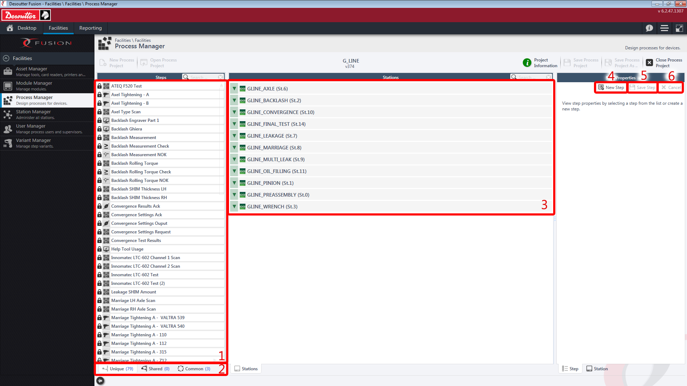
Features
Overview Presentation Settings Station update
Process Manager Overview
Process Manager allows the user to create and edit steps as well as assign them to a station.
Step Library - List of available in the open project of a selected Step Type
Step Type – Allows the user to choose which type of step to view in the step library
Stations – Shows user all stations listed within the process and allows the user to drag step into an applicable station
New Step – Allows the user to create a new step and define properties
Save Step – Allows a user to save changes to an open step
Cancel – Allows the user to cancel the creation of a step or close an open step without saving unsaved changes
24

Slide 25
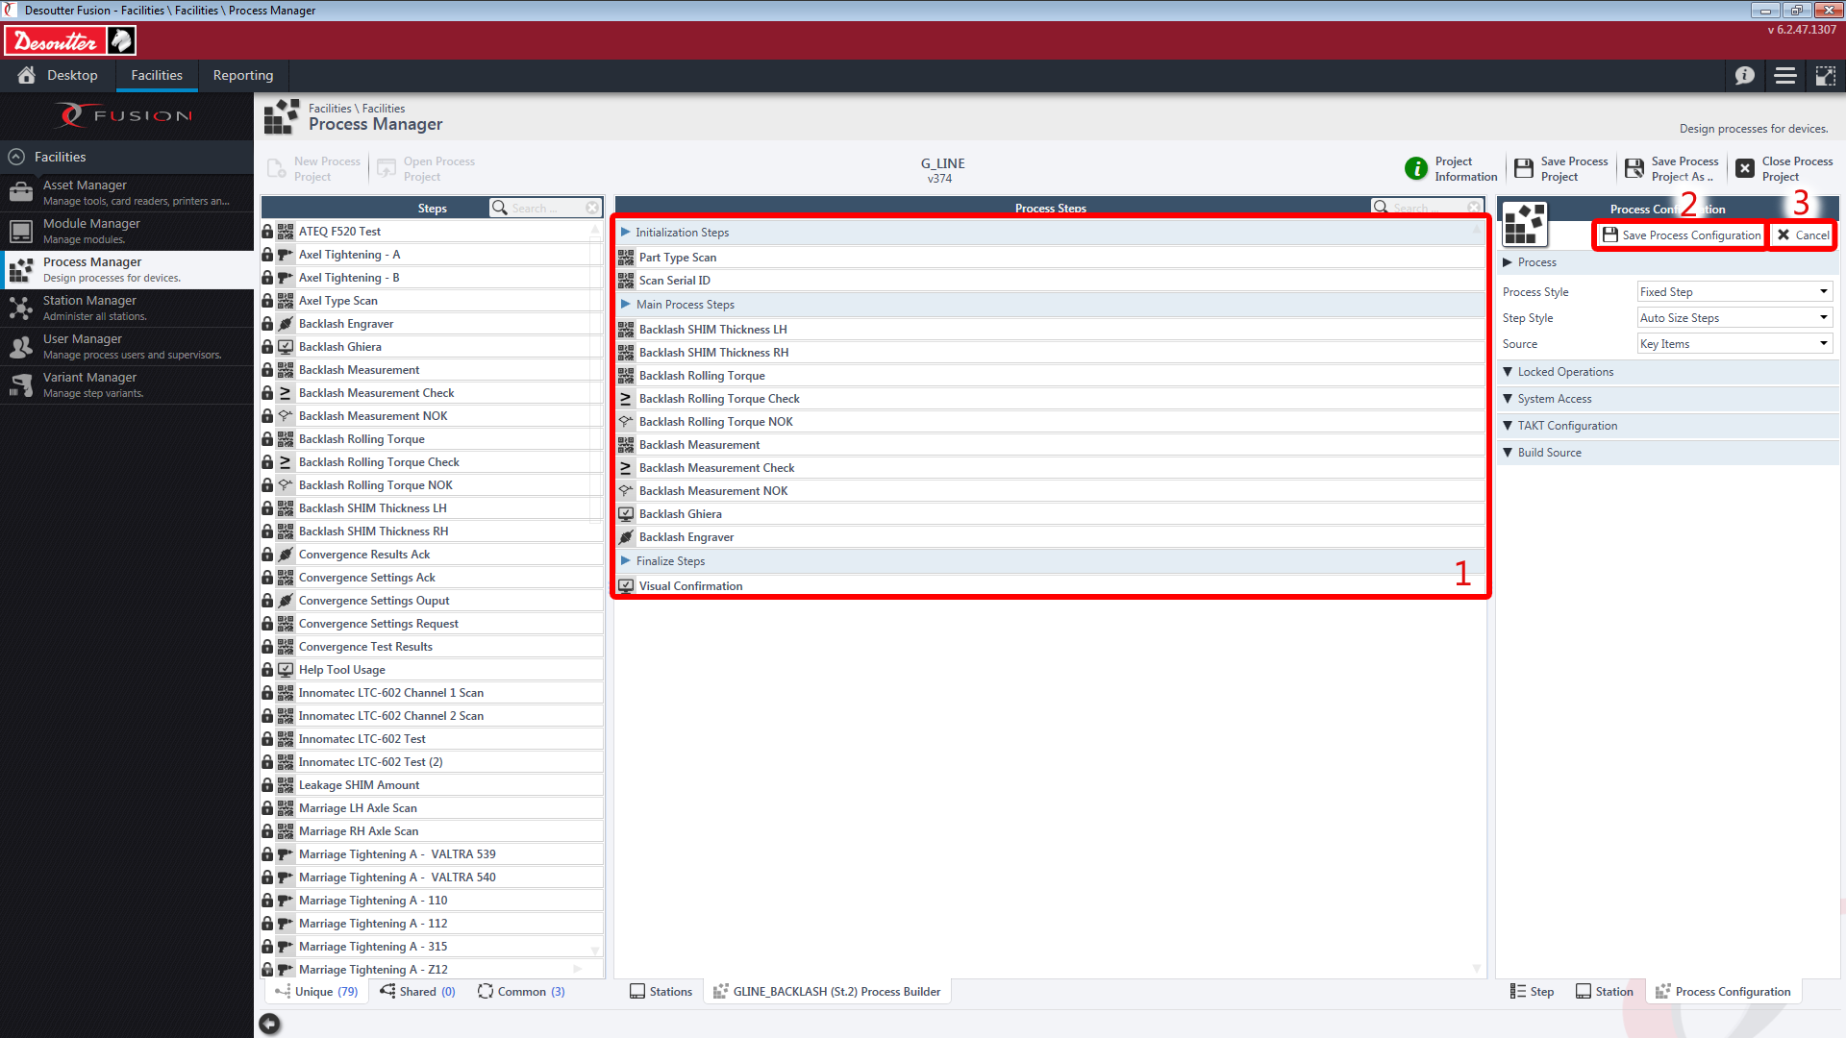
Features
Overview Presentation Settings Station update
Process Builder Overview
The user can enter into the process builder by right-clicking on a station and selecting the menu. Process Builder allows the user to create/edit steps.
Process Steps – Lists all steps inside of the process and allows the user to rearrange them in the appropriate order for a station
Save Process Configuration – Allows the user to save changes to an open process configuration
Cancel – Allows the user to cancel unsaved changes to a process configuration
25

Slide 26
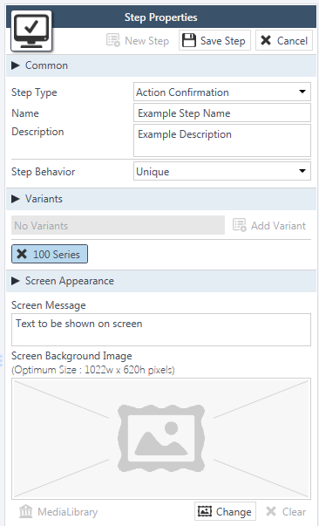
Features
Overview Presentation Settings Station update
Process Manager : Common Step Properties
Available Properties
- Step Type – Defines the type of step/actions to take
Name - Defines the name of the step
Description – Defines a description of the step
- Variants- Defines what variants are applicable to the step if they are found in the build data
- Screen Message – Defines the text to be shown to the Infinity user
- Screen Background Image – Defines the image to be shown on that step in the process
26

Slide 27
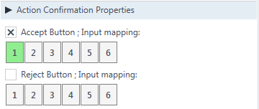
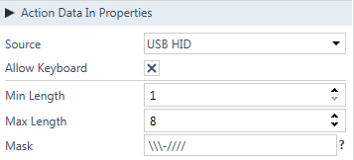
Features
Overview Presentation Settings Station update
Process Manager : Step Specific Properties
Once a step has been assigned to a station, station specific properties underneath the common properties become accessible. The properties rely on information about the station and associated assets and so are not available until assigned. See below for all extended properties of each step type.
Action Confirmation
- Allows Fusion user to define whether Infinity will use an ‘accept’ and/or a ‘reject’ button and whether they can use I/O if any has been assigned in Station Properties
Action Data In
- Allows Fusion user to define acceptable parameters for data being received on a step
27

Slide 28
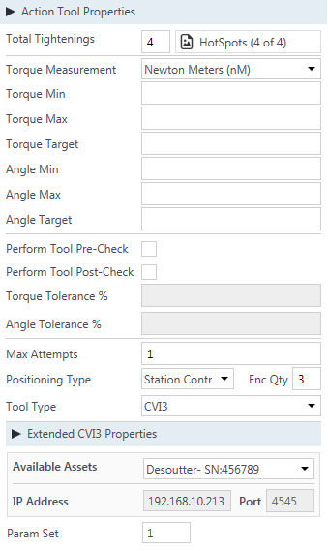
Features
Overview Presentation Settings Station update
Process Manager : Step Specific Properties
Action Tool
Allows Fusion user to define controllable parameters about tightenings. User has the ability to:
Define the number of tightenings to be done for that step
Add visual hotspots to a screen image
Define P-set parameters and check them against current settings in a connected tool
Define the number of attempts an Infinity user has on each fixing
The type of tool to use for the step
28

Slide 29
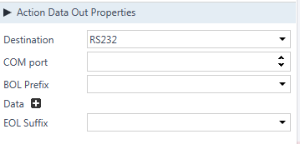
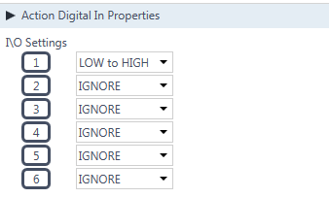
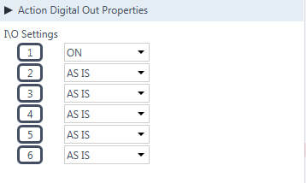
Features
Overview Presentation Settings Station update
Process Manager : Step Specific Properties
Action Data Out
- Allows Fusion user to define data being sent by Infinity to an external source
Action Digital In
- Allows Fusion user to define an input to detect before the process will continue.
Action Data Out
- Allows Fusion user to define the state of an output.
29

Slide 30
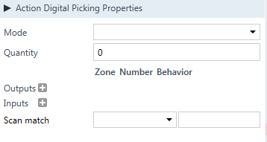
Features
Overview Presentation Settings Station update
Process Manager : Step Specific Properties
Action Digital Picking
- Allows Fusion user to define an output to be changed state and then to wait for a defined input. User can also define that a scan is required and the expected data.
Action Digital In
- Allows Fusion user to define an input to detect before the process will continue.
Action Data Out
- Allows Fusion user to define the state of an output.
30

Slide 31
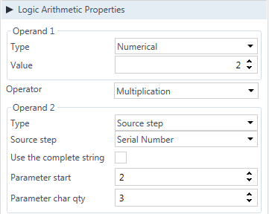
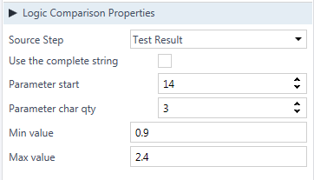
Features
Overview Presentation Settings Station update
Process Manager : Step Specific Properties
Logic Arithmetic
- Allows Fusion user to apply basic maths to defined numeric values or to source steps
Logic Comparison
- Allows Fusion user to define a minimum and maximum value for a source step or portion of a string
31

Slide 32
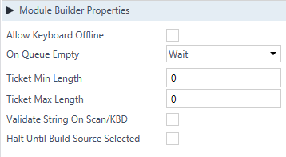
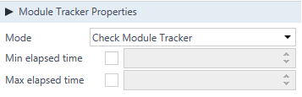
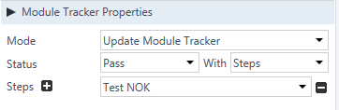
Features
Overview Presentation Settings Station update
Process Manager : Step Specific Properties
Module Builder
- Allows user to define properties of the builder step (what will happen when Infinity is expected to use data supplied by the Builder module)
Module Tracker (Check)
- Allows the Fusion User to check with tracker whether the part being built is allowed to continue with the cycle. Min and Max elapsed times can be set if required.
Module Tracker (Update)
- Allows the Fusion User to update the status of the part based on UID with a pass on the current or fail on the current station. This pass or fail can be based on specific define steps or a whether a range of steps was passed.
32

Slide 33
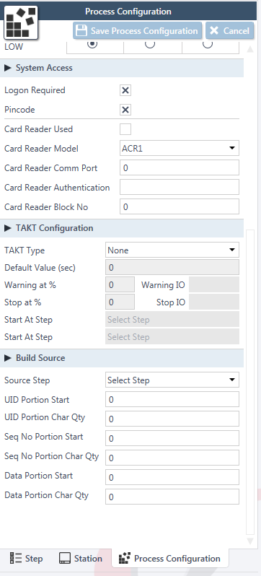
Features
Overview Presentation Settings Station update
Process : Process configuration in Process Builder
System access:
Defines the access that is mandatory in order to execute the process
TAKT Configuration:
Defines the TAKT time of the process
Build source:
Defines the portion of the build ticket/string to be used as a unique Identifier, to be used
as a sequence number and to be used as data to be compared with variant data.
33

Slide 34
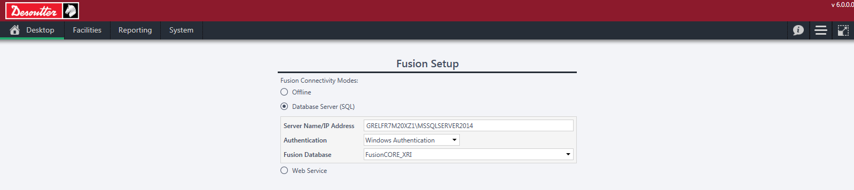
Features
Overview Presentation Settings Station update
Reporting : Fusion settings
Results are stored in a SQL Server database (SQL Server 2014)
You can create a connection to the database in the Fusion Setup options. Both Windows or SQL authentication are accepted.
Once connected, you will be able to read traceability stored in the database inside of CVI Fusion and all projects are automatically backed up the database in real time.
34

Slide 35
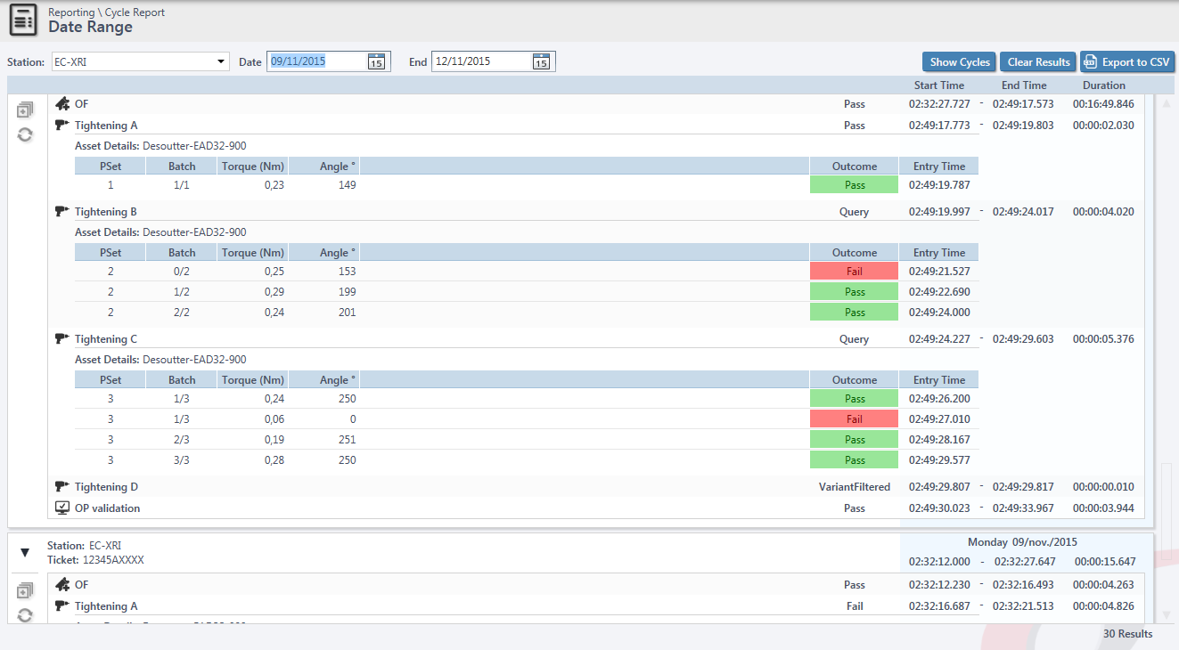
Features
Overview Presentation Settings Station update
Reporting : Results display
35

Slide 36
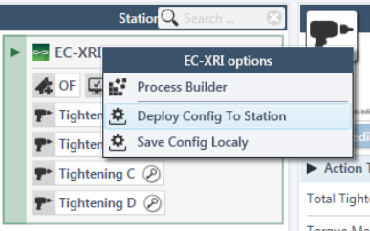
Station update
Overview Presentation Features Station update
How to download the configuration in the station ?
In Fusion software :
The station must be switched on and the Infinity client must be started
The IP address of the station must be the same as the one set in the station properties.
Right click on the station name when in process manager and select « Deploy Config to Station »
A finish deployment message will display in the bottom-right hand corner of Fusion when completed.
36

Slide 37
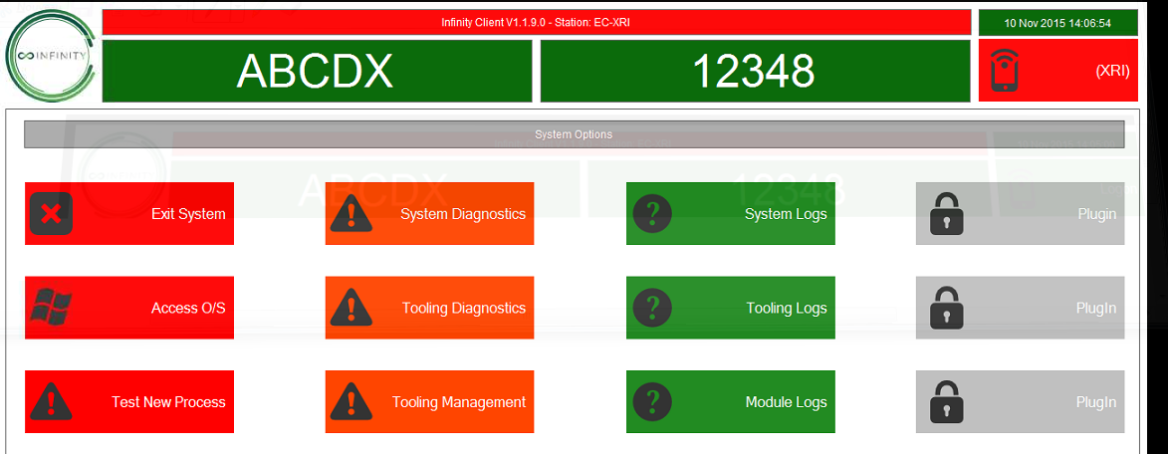
Station update
Overview Presentation Features Station update
How to download the configuration in the station ?
In Infinity station :
After the deployment from Fusion, the top banner will flash between green and red.
Ensure a supervisor account is logged in to allow adequate permissions.
Go in the main menu and click on « Test New Process »
The Infinity client software restart automatically and backup the previous process.
37

